Slide 1
NLP Project 2:
Reading Comprehension / Question Answering
By Ziming Liu, Hunter Price, and Logan Wrinkle

Slide 2
Context
Author:
  Arthur Conan Doyle
Book:
  Hound of the Baskervilles

Slide 3
Part 1 - Translation method
Tasked with translating to and from Swahili and Spanish
First broke 500 token passages into sentences using spaCy
Next we ran it through the M2M100 model twice (to and from english) and stored the results into files.
Took about 20 minutes to run in total

Slide 4
Part 1 - Translation Results
Levenshtein distance as a percentage
  1-(distance/max(eng_len, sw/sp_len))
  Avg Spanish - 71.8%
  Avg Swahili - 50.5%

Slide 5
Part 1 - Translation Results
Original
I believe you have eyes in the back of your head.”
“I have, at least, a well-polished, silver-plated coffee-pot in front of me,” said he.
Spanish
I think you have eyes on the back of your head.”
“I have at least a cup of well-polished and silver-plated coffee in front of me,” he said.
Swahili
I am very pleased to take you with Jerry.
“There was, unfortunately, a brick of the brick of the brick in front of me,” he said.

Slide 6
Part 2 - Named Entity Recognition
Tasked with extracting entities from text sections using bert-base-NER
Fine-tuned the model with Wikiann, EN dataset
Compare the performance of two models

Slide 7
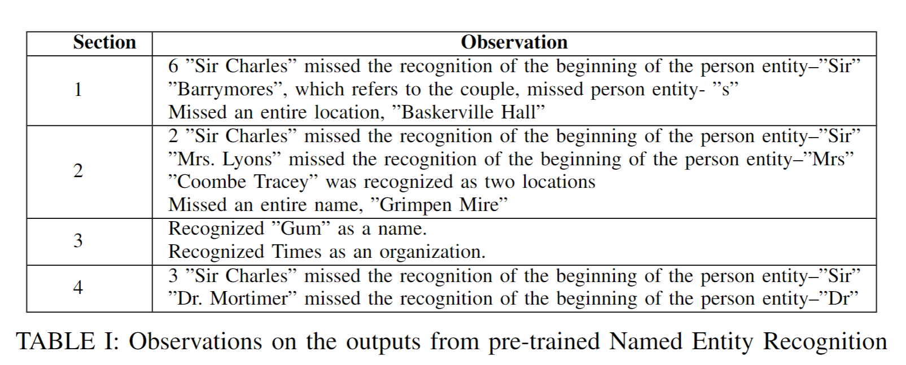
Part 2 - Named Entity Recognition

Slide 8
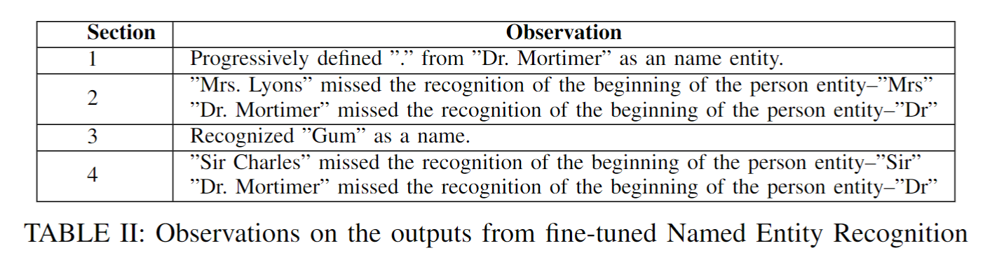
Part 2 - Named Entity Recognition
Dataset | WikiAnn, EN
Learning Rate | 1e-4
Epochs | 3
Weight Decay | 0.01
Batch Size | 16

Slide 9
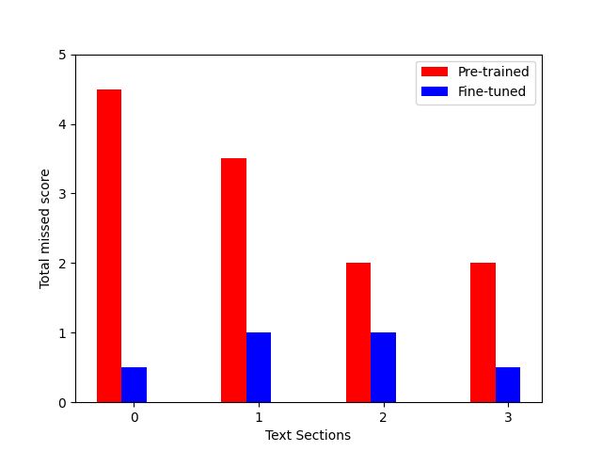
Part 2 - Named Entity Recognition

Slide 10
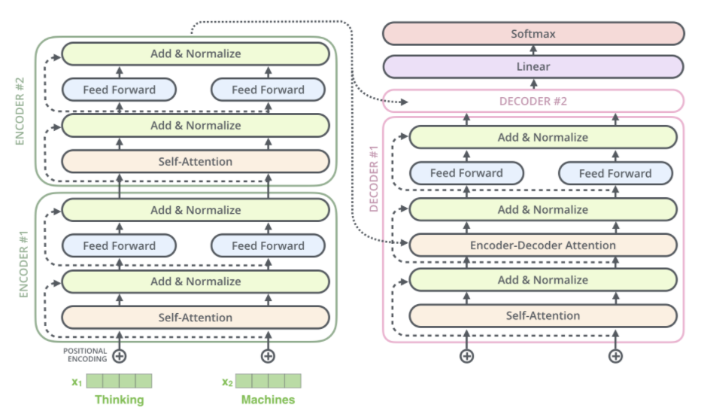
Part 3 - Auto-Summarization
Task:
  Auto-Summarization
Model:
  T5
Input:
  4 Prompts
Evaluation:
  Qualitative Analysis
  ROUGE score
  Model Comparison

Slide 11
Part 3 - Auto-Summarization
Manual Summarization:
  Holmes has deduced from the cut-out letter that it was composed by an educated person who was trying to appear uneducated, and was likely posted in a hurry due to the letter being important.He is unsure why it was, but suggests that it could have been due to the fear of an interruption.
Generated Summarization:
  "the other words were all simple and might be found in any issue, but 'moor' would be less common" "have you read anything else in this message, Mr. Holmes?" he asks. "the address, you observe, is printed in rough characters, but the times is a paper which is seldom found in anyone but those of the highly educated"

Slide 12
Part 3 - Auto-Summarization Results
Ground Truth |  |  | Prediction
# | Situation | Key Details | Details | Grammar | Conclusion
1 | Details of the case. | Victim goes for a habitual walk Body found at the end of alley. Body found with no indication of violence. Body had facial distortion. Next of kin must be found for inheritance. | Mentions victim has a habit. Mentions evidence with no detail. Mentions need to find victims heir. | Poor | Aptly described situation. Provided no details.
2 | Description of the murder. | Perp found a way to lure victim. Perp pressures Mrs. Lyons write letter to victim. Perp gets and paints his hound and waits for victim. Hound pounces at victim. Victim dies from heart disease and terror. | Mentions perp acquired influence over Mrs. Lyons. Mentions perp had Mrs. Lyons write a letter to victim. | Poor | Aptly describes first portion of text. Does not provide any details of second half of text.

Slide 13
Part 3 - Auto-Summarization Results
Ground Truth |  |  | Prediction
# | Situation | Key Details | Details | Grammar | Conclusion
3 | Description of clue. | Describes perp took care to remove clues. Letter printed in rough characters. Perp tried to seem uneducated. Perp was careless and in a hurry Holmes questions why the perp was in a hurry. | Describes the victims attempt at seeming uneducated. Describes the rough characters. | Average | Describes high level details. Mentions a few key details.
4 | Description of victim. | Describes that rumors surround victims death. Describes that there is no reason to suspect foul play or natural causes. Victim showed poor health conditions. | Describes there is no reason to suspect foul play. Mentions circumstances of victims death are not cleared up. | Average | Repeats sentence of the input. Has a single key detail.

Slide 14
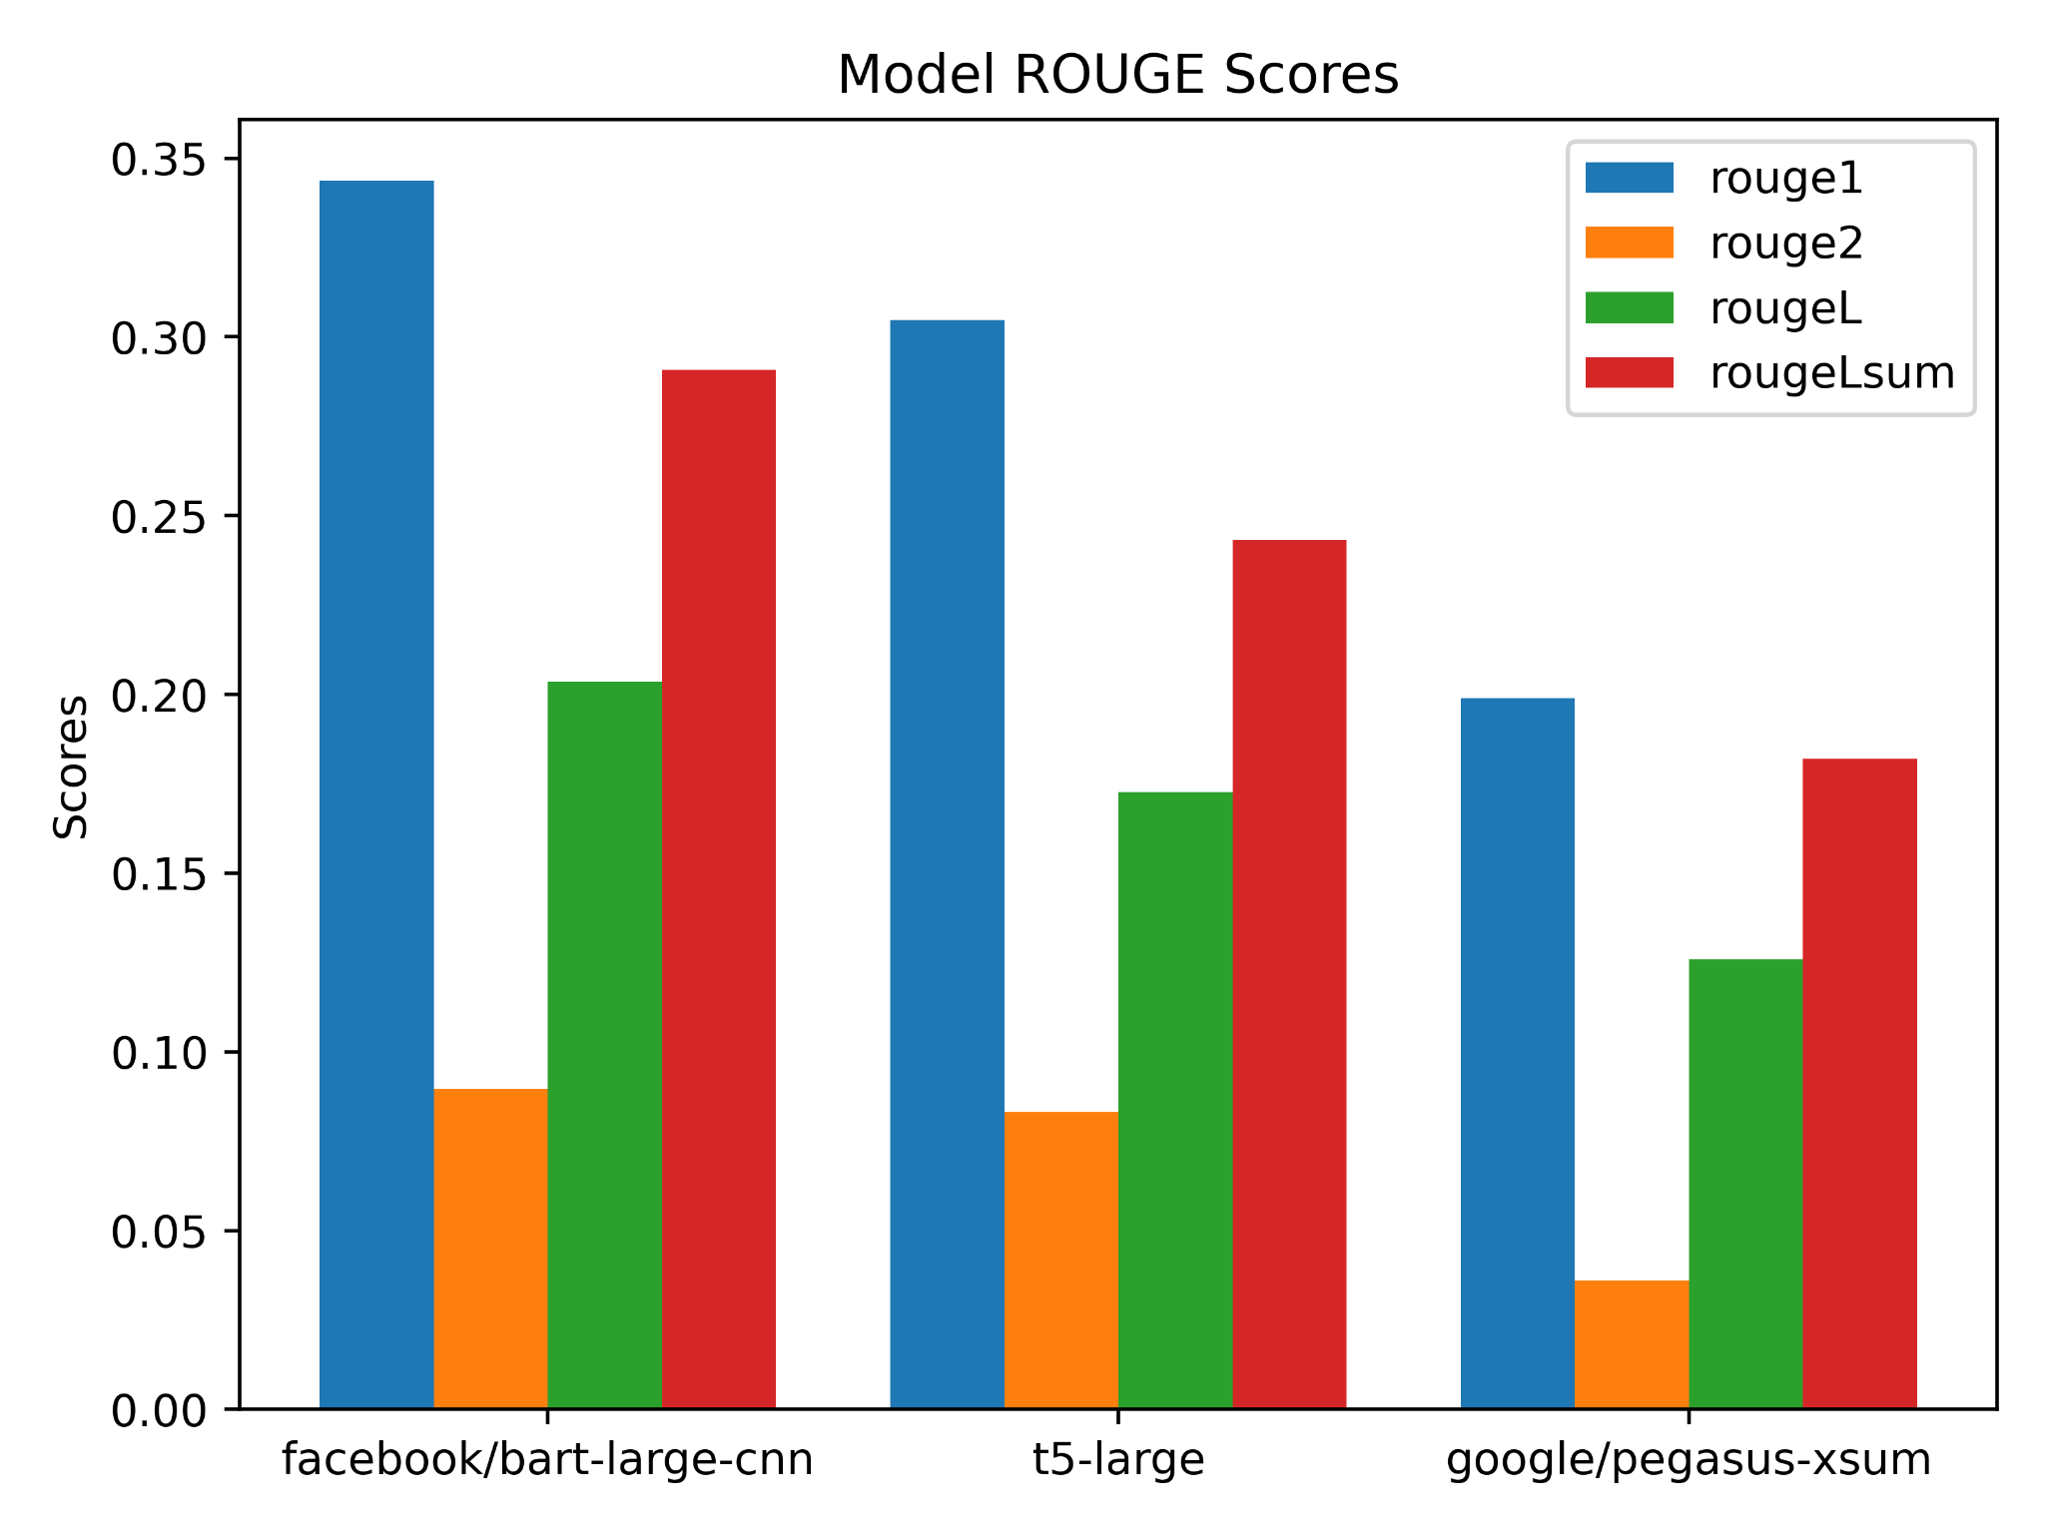
Part 3 - Auto-Summarization Results
Model | rouge1 | rouge2 | rougeL | rougeLsum
T5 | 0.3047797 | 0.083135 | 0.172717 | 0.2431638
facebook/bart-large-cnn | 0.3436942 | 0.089570 | 0.203602 | 0.2907315
google/pegasus-xsum | 0.1988781 | 0.035910 | 0.125907 | 0.1819739

